Slide 1
Data Mining and Data Science Problems
Geospatial Data Seminar

Slide 2
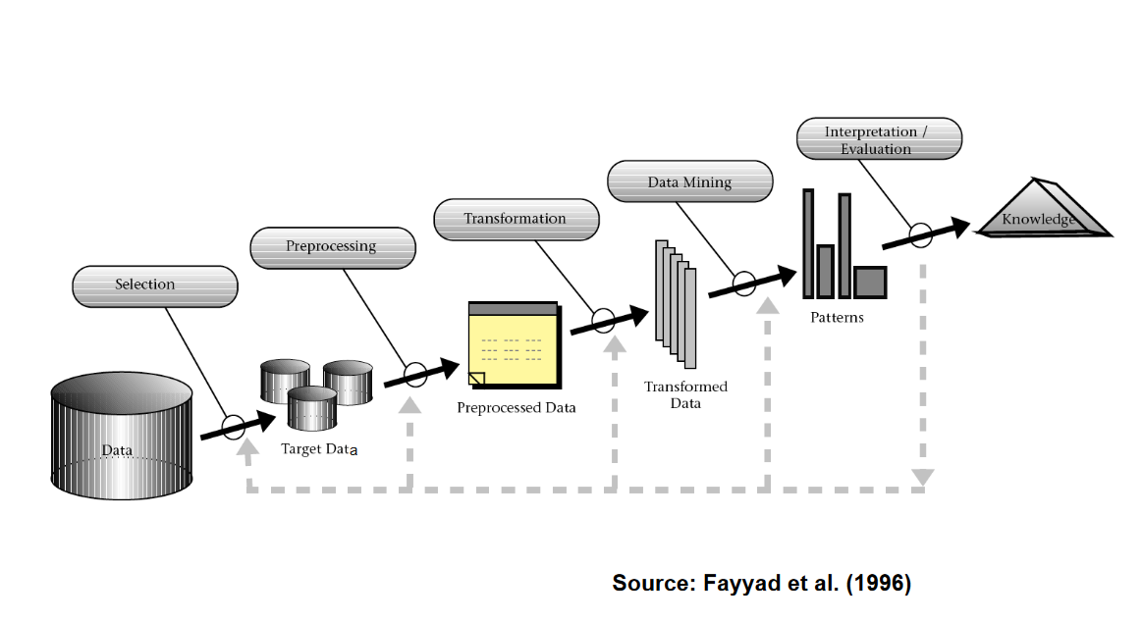
The Data Mining Process

Slide 3
Data Cleaning
https://medium.com/well-red/cleaning-a-messy-dataset-using-python-7d7ab0bf199b
Notes:
Cleaning and Preparation
Handing missing values
Normalizing data
Outliers

Slide 4
Feature Extraction
Features to describe data
https://help.xlstat.com/6751-feature-extraction-tutorial-excel
Notes:
used to reduce the number of resources required to describe a large set of textual data

Slide 5
Feature Selection
Methods
Filter-based methods
Classifier-independent
Simple and efficient
Wrapper-based methods
Embedded methods
https://www.eurosdr.net/sites/default/files/images/inline/05-2019-12-04_presentation_pcp_workshop_weinmann.pdf
Notes:
Identification of
Relevant features
Important variables
Reduction of dimensionality
Improves efficiency and accuracy

Slide 6
Model Selection
Classification Models
Decision Trees
Support Vector Machines
Clustering
Regression Models
Linear Regression
https://medium.com/greyatom/what-is-underfitting-and-overfitting-in-machine-learning-and-how-to-deal-with-it-6803a989c76

Slide 7
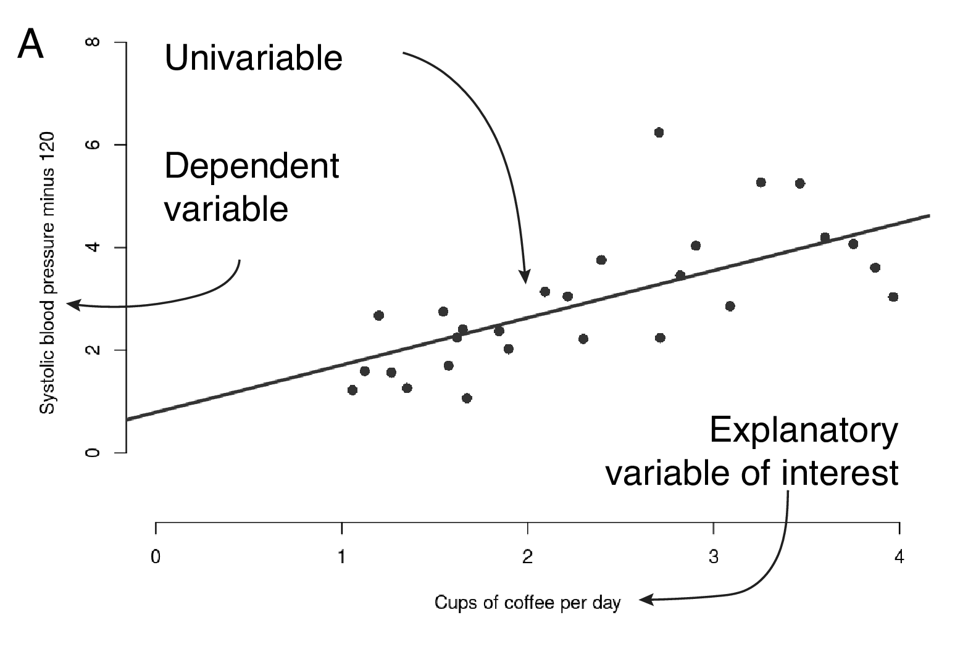
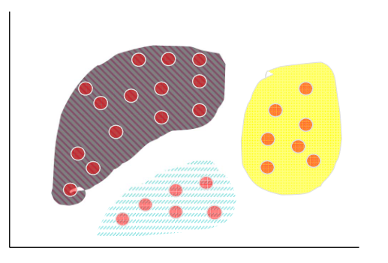
Linear Regression & Clustering
https://argoshare.is.ed.ac.uk/healthyr_book/regression.html
https://www.uni-mannheim.de/media/Einrichtungen/dws/Files_Teaching/Data_Mining/Slides/DMI00-Intro-FSS2020.pdf

Slide 8
Model Evaluation
Accuracy
How often is the model correct
Precision
Measures quality of positive predictions
Recall
How many correct predictions are being made
F1-score
Harmonic mean of precision and recall

Slide 9
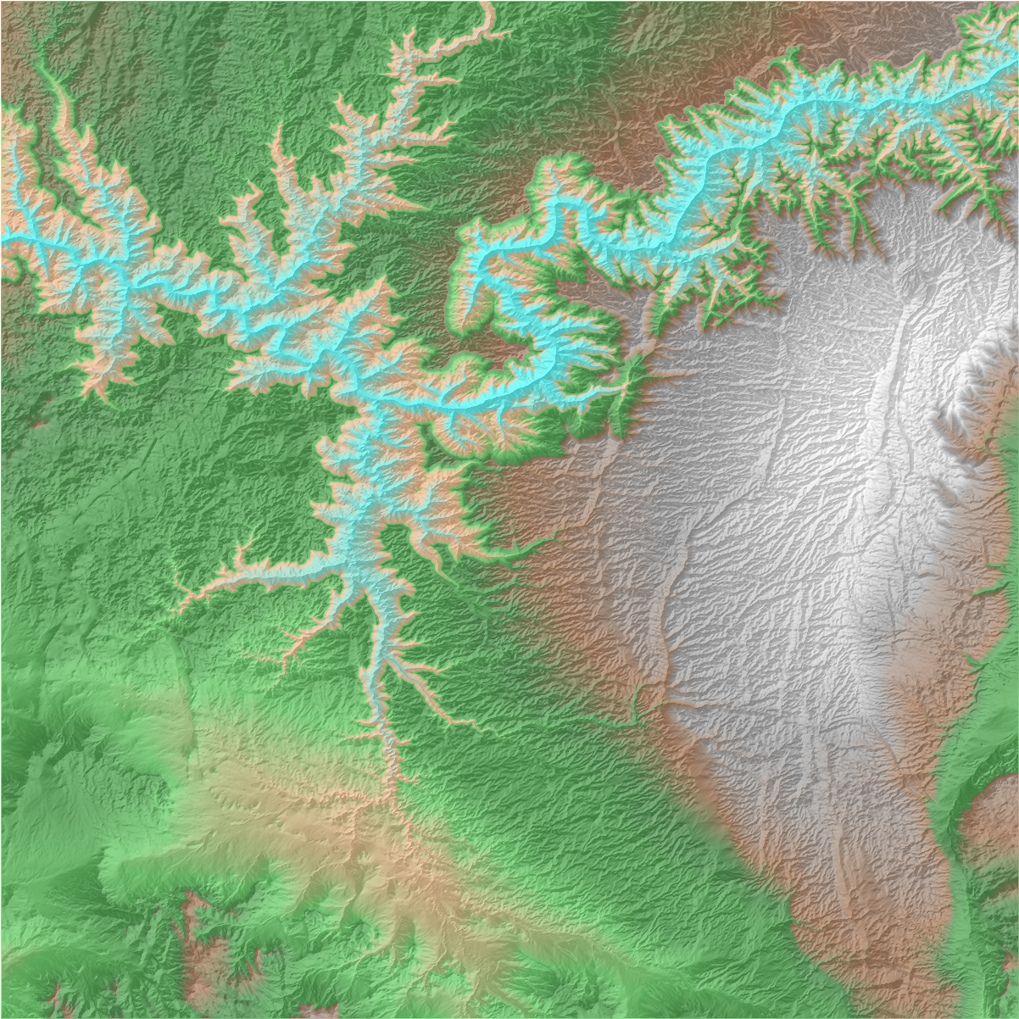
Geospatial Data analysis
How does the data mining workflow
change with geospatial data ?
https://github.com/DLR-terrabyte/eo-examples/blob/main/datasets/CopernicusDEM.ipynb

Slide 10
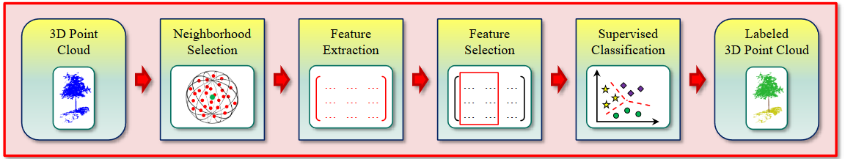
A typical workflow for classification
https://www.eurosdr.net/sites/default/files/images/inline/05-2019-12-04_presentation_pcp_workshop_weinmann.pdf

Slide 11
(Co-)Registration
Iterative Closest Point (ICP) algorithm
Feature-based matching methods
https://www.thinkautonomous.ai/blog/point-cloud-registration/
Notes:
Techniques
Iterative Closest Point (ICP) algorithm
feature-based matching methods

Slide 13
Segmentation
Major approaches
Euclidean clustering
K-Nearest-Neighbor
Spatial neighborhood
Notes:
Different segments in pcd (point cloud data)
Multiple homogenous regions or clusters with similar properties

Slide 14
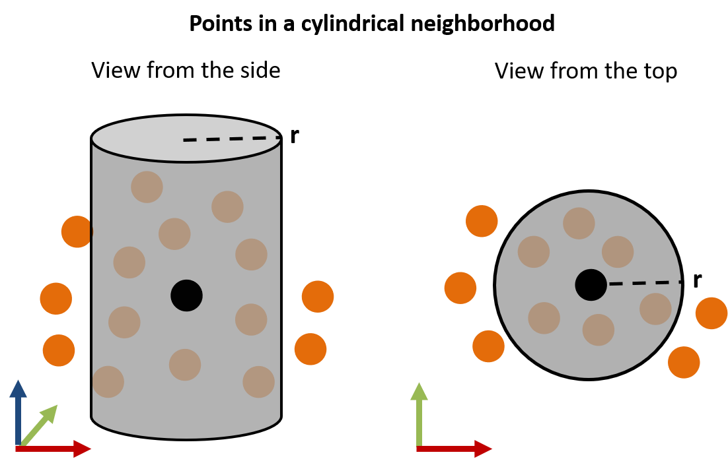
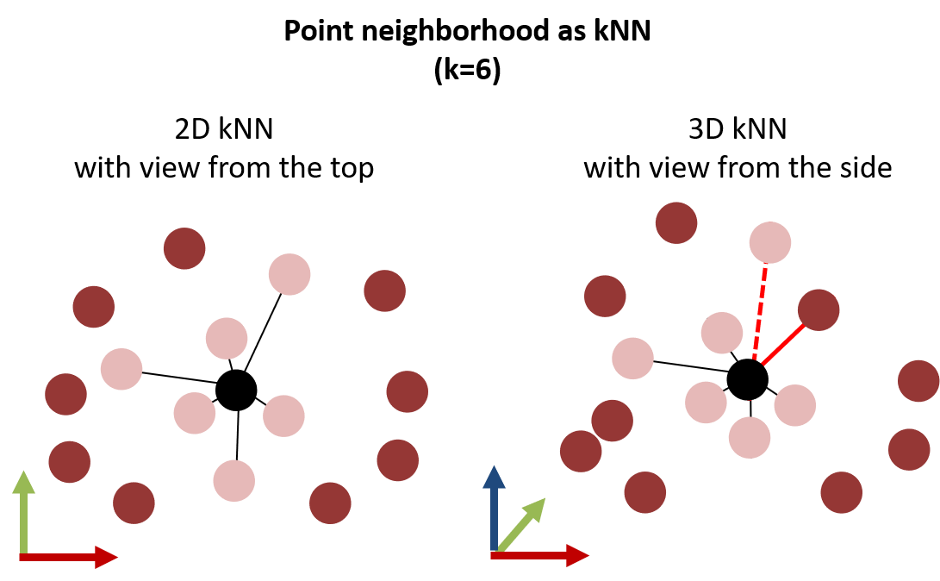
Spatial neighborhood
https://3dgeo-heidelberg.github.io/etrainee/module3/01_pointcloud_principles/01_pointcloud_principles.html
https://3dgeo-heidelberg.github.io/etrainee/module3/01_pointcloud_principles/01_pointcloud_principles.html

Slide 15
A typical workflow for classification

Slide 16
Feature Extraction
3D-features
Eigenvalues
Geometric properties
2D-features
M. Weinmann, B. Jutzi, C. Mallet, and Mi. Weinmann (2017): Geometric features and their relevance for 3D point cloud classification. ISPRS Annals of the Photogrammetry, Remote Sensing and Spatial Information Sciences IV-1/W1, pp. 157-164

Slide 17
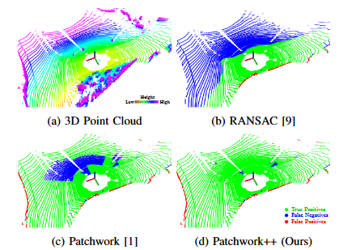
Ground Removal
Algorithms
RANSAC
Ground Plane Fitting (GPF)
Patchwork++
https://arxiv.org/pdf/2207.11919

Slide 18
Ground Removal
RANSAC (random sample consensus)
https://scikit-learn.org/stable/auto_examples/linear_model/plot_ransac.html
Notes:
Fitting planar surfaces within point cloud data
Identification of flat surfaces
Walls
Floors
Tables
Algorithms
Least squares fitting
RANSAC
Fitted plane is prone to be influenced by noise

Slide 19
Before and after data cleaning
https://www.semanticscholar.org/reader/74f6d9557df0bc3409cb590c7892aa57b6663dc1

Slide 20
A typical workflow for classification

Slide 21
A typical workflow for classification

Slide 22
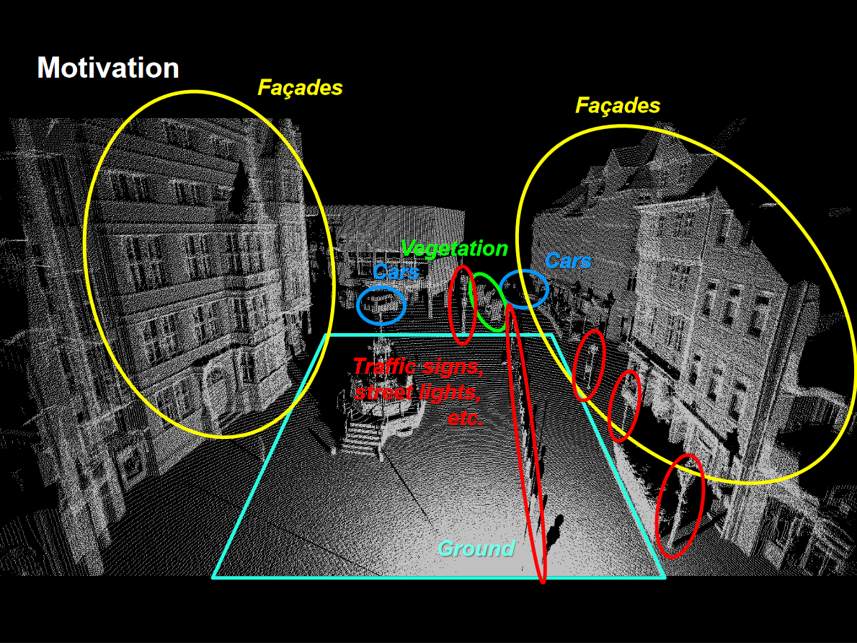
Classification

Slide 23
Classification
Various algorithms
Nearest Neighbour (NN) classifier
Decision Tree (DT)
Naïve Bayesian (NB) classifier
Linear Discriminant Analysis (LDA)
Support Vector Machine (SVM)
Random Forest (RF)

Slide 24
A typical workflow for classification

Slide 25
Classified image
https://desktop.arcgis.com/en/arcmap/latest/manage-data/las-dataset/lidar-point-classification.htm

Slide 26
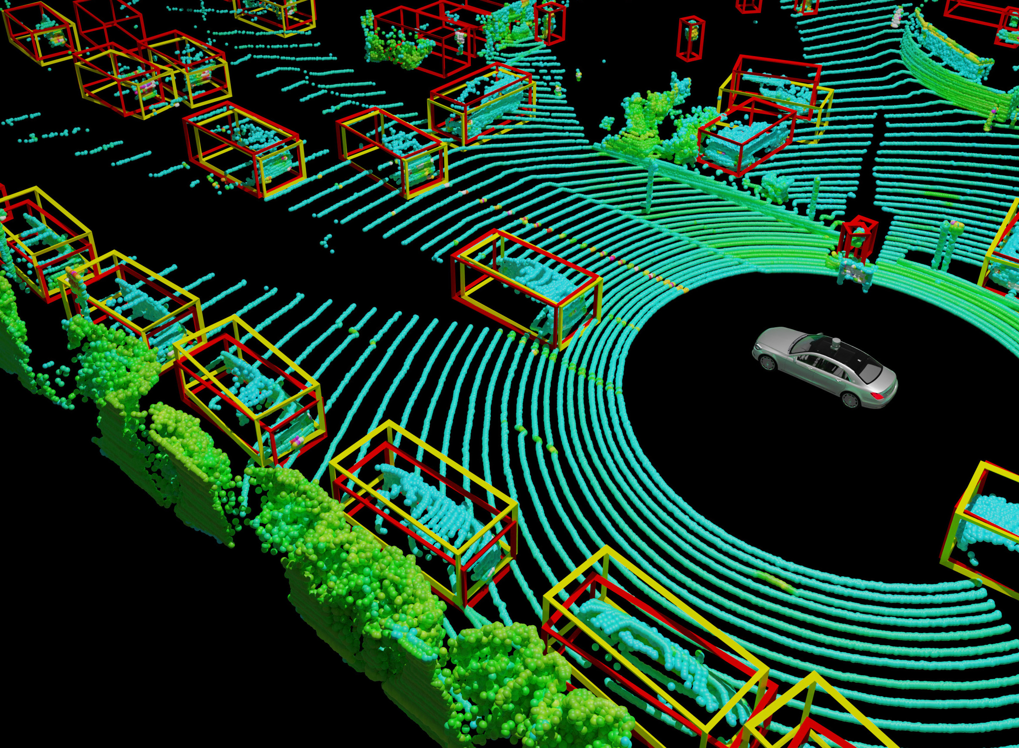
Object Detection
https://arxiv.org/html/2403.07071v1

Slide 27
Outlook: Point-NET
Direct processing of raw point cloud data
Representation learning
https://stanford.edu/~rqi/pointnet/
Notes:
Features describing the data, is learned from the data itself
Algorithm learns how to make it easy for classification and regression

Slide 28
Questions?
https://www.aeroscout.ch/index.php/reference-stories/nasa-gedi-project-lidar

Slide 29
Leftover

Slide 30
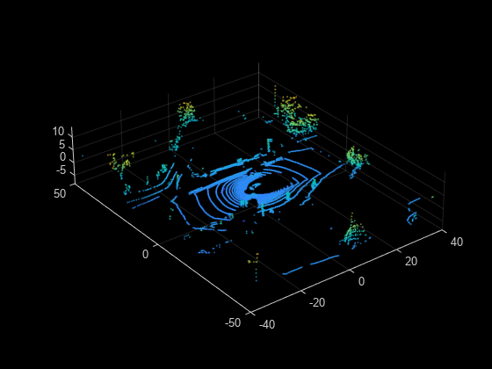
Ground Removal
fileName = fullfile(toolboxdir("lidar"),
"lidardata","las", ...
"aerialLidarData2.las");
lasReader = lasFileReader(fileName);
ptCloud = readPointCloud(lasReader);
[groundPtsIdx,nonGroundPtCloud,groundPtCloud] = segmentGroundSMRF(ptCloud);
figure
pcshowpair(groundPtCloud,nonGroundPtCloud)

Slide 31
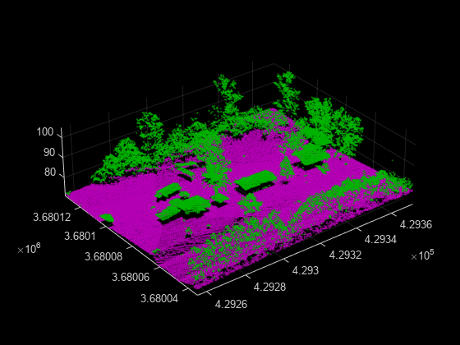
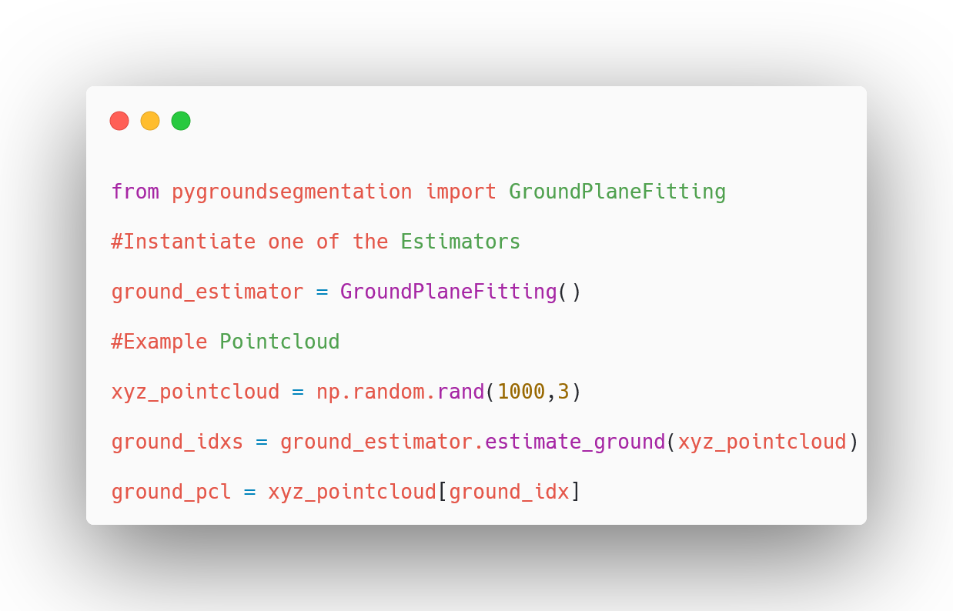
Ground Plane Fitting

Slide 32
Mitigate Noise in Plane fitting
Pre-processing
Noise filtering
Smoothing
Robust Algorithms (RANSAC)
Data Segmentation
Clustering
Likely to belong to the same surface
Post-Processing
Removing iteratively outliers

Slide 33
Data Representations
Point-based
Voxel-based
Reduces memory needs thus more computationally efficient
Frustum-based
Pillar-based
Excludes the z-coordinate
Projection-based
Reduce size for cost

Slide 34

Overview
Data Mining
Pre-processing
Feature selection
Model selection
Model evaluation
Geospatial Data Mining
Data Representation
Ground removal
Plane fitting
(Co-)Registration
Segmentation
Classification
Object Detection

Slide 35

Model Training

